Slide 1
NIWA Activities UM-based NWP & Climate work at NIWA
Stuart Moore (on behalf of many)
ACCESS Science Days 10-11 June 2021

Slide 2
Outline
NWP
Operational NWP
NWP research
Forecasting Services
Data Science
Climate
The Deep South Challenge
NZESM

Slide 3
Operational NWP
 | NZLAM-4 | NZENS (per member) x 18 | NZCSM | AKL 1.5km | AKL 333m
Domain Size | 900 x 900 x 70 (L70_80km) | 400 x 450 x 70 (L70_40km) | 1200 x 1350 x 70 (L70_40km) | 300 x 300 x 140 (L70_40km) | 300 x 300 x 140 (L140_40km)
ICs / LBCs | UKMO Global | MOGREPS-G | NZLAM4 | NZLAM4 | AKL 1.5
Science | UM10.4 OS38 GA6 + 3D VAR + local edits | UM 10.9 RAL1-M | UM 10.4 OS38 UKV + pseudoDA | UM 11.4 RA2-T | UM 11.4 RA2-T
Forecast period / frequency | T+75 (4x daily) | T+120 (2x daily) | T+51 (4x daily) | T+36 (4x daily) | T+36 (4x daily)
Output frequency | Hourly | Hourly | 30min | 10min | 10min
Stuart Moore, Phil Andrews, Jorge Bornemann, Trevor Carey-Smith
Notes:
In Operations
NZLAM
4·4km, 900x900 points horizontal; L70_80km vertical.
Frames for lateral boundaries are provided by the Met Office glm.
Science: UM10.4 OS38 glm based (parameterised convection)
Source filtering switched off to improve subgrid orographic gradients in the orog ancil.
Analyses
OPS/VAR 2016.11 glm based 3dvar cycled 6 hourly
Var grid: 324x324 horizontal
Reduced thinning scales c.f. glm (more like UKV)
SatRad bias corrections updated every cycle from 3 week rolling archive of Bstat files.
CVT generated background error covariance estimates updated daily from 2 week rolling archive of T+12 and T+6 forecast pairs (generated from every NZLAM cycle).
Soil moisture updated every cycle from the met office glm analysis.
SST updated daily from the OSTIA analysis.
NZCSM
1.5km 1200x1350 horizontal; L70_40km vertical.
Frames for the lateral boundaries are provided by the NZLAM.
Science: UM10.4 OS38 ukv based (explicit convection)
Analyses: pseudo analysis to transfer NZLAM analysis to NZCSM
Soil moisture updated from met office glm analysis every cycle.
SST updated daily from OSTIA analysis.

Slide 4
Operational NWP
 | NZLAM-4 | NZENS (per member) x 6 ?? | NZCSM | AKL 1.5km | AKL 333m
Domain Size | 900 x 900 x 70 (L70_80km) | 400 x 450 x 70 (L70_40km) | 1200 x 1350 x 70 (L70_40km) | 300 x 300 x 140 (L70_40km) | 300 x 300 x 140 (L140_40km)
ICs / LBCs | UKMO Global | MOGREPS-G | NZLAM4 | NZLAM4 | AKL 1.5
Science | UM 11.4 OS44 GA6 + local edits | UM 11.4 RAL2-M | UM 11.3 RAL2-M + 3D VAR DA + local edits | RA2-T | RA2-T
Forecast period / frequency | T+75 (4x daily) | T+120 (4x daily) | T+51 (4x daily) | T+36 (4x daily) | T+36 (4x daily)
Output frequency | Hourly | Hourly | 30min | 10min | 10min
Stuart Moore, Phil Andrews, Jorge Bornemann, Trevor Carey-Smith
Notes:
In development
NZLAM (in research trials)
Science: UM11.4 OS44 glm (parameterised convection); UM11.3 RA2M; UM11.4 PS44 UKV. Is further from glm than previous NZLAM’s.
Tries to allow more explicit convection
cldbase_opt_dp=4, cldbase_opt_md=4
Uses RA2M for
Subgrid scale horizontal diffusion
Boundary layer
Convective diagnosis
Jules, apart from a few GA6 settings…
can_model=4
ch_nvg_io=2.8e+5,2.11e+7,0.0,0.0
vf_nvg_io=1.0,1.0,0.0,0.0
z0hm_pft_io=1.65,1.65,0.1,0.1,0.1
no urban tiling
l_gw_heating=false,false,false (improves surface temperature bias)
OPS/VAR 2020.01
Including using SatRad on model levels as per OS44 glm.
NZCSM (in pre operational trials)
Science: UM11.3 RA2M based science (explicit convection)
Switches on glm gravity wave drag scheme
Interpolates the subgrid scale orographic gradient ancil fields from the NZLAM as the source dataset has too low resolution to calculate these accurately.
Analyses:
OPS/VAR 2016.11 glm based 3dvar analysis cycled 6 hourly
As operational NZLAM apart from SatRad channel selections.
SatRad bias corrections updated every cycle from 3 week rolling archive of Bstat files.
CVT generated background error covariance estimates updated daily from 2 week rolling archive of T+12 and T+6 forecast pairs (generated from every NZCSM cycle).

Slide 5
NWP Research
Model updates, site-specific forecasts and evaluation
Phil Andrews, Stuart Moore, Trevor Carey-Smith, Jorge Bornemann
Notes:
NZLAM, NZCSM, NZENS science updates
NZENS lagged set up, and NZLAM-centring
Vertical resolution changes for satellite DA

Slide 6
NWP Research
Model updates, site-specific forecasts and evaluation
Cross-NIWA collaboration with downstream modellers
Hydrology (TopNet)
Inundation and Coastal (RiCOM, Basilisk)
Wave modelling (Wavewatch III, SWAN) incl. Regional Coupled Modelling (Auckland Model <> Wavewatch III)
Hydrodynamics (Delft3D)
RiskScape
Stuart Moore, Trevor Carey-Smith, Richard Turner

Slide 7
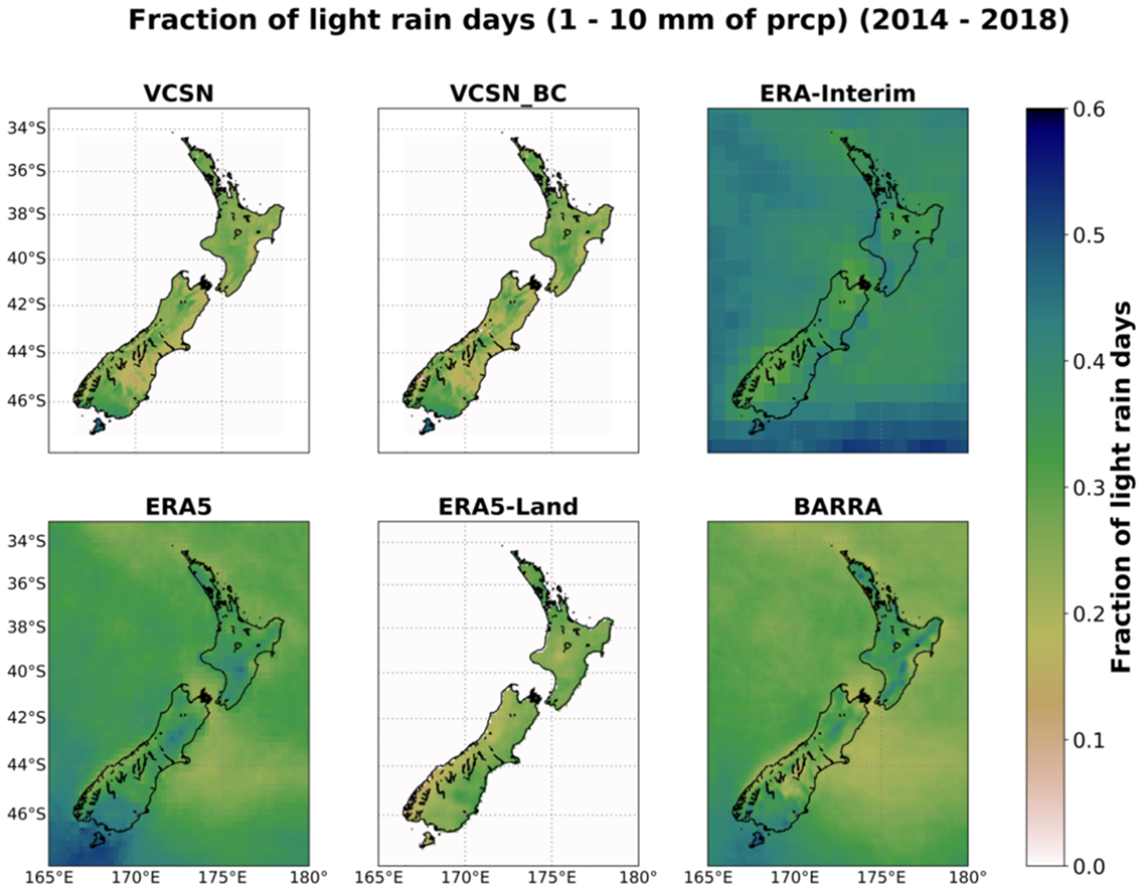
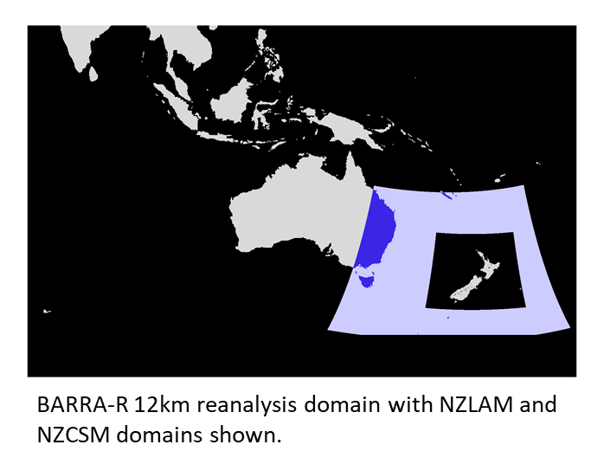
NWP Research
Model updates
Cross-NIWA collaboration with downstream modellers
NZ Reanalysis
Amir Pirooz, Stuart Moore, Chun-Hsu Su (BoM), Nathan Eizenberg (Uni. Melbourne)
Notes:
1990-2019 BARRA-R downscaling over NZ at 1.5km

Slide 8
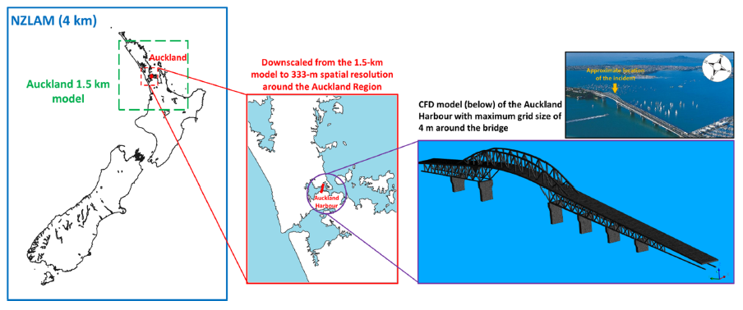
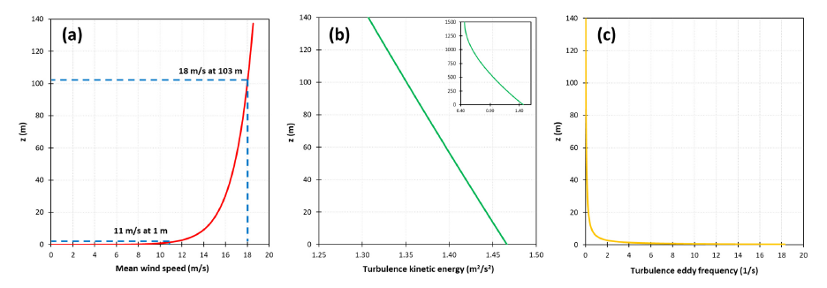
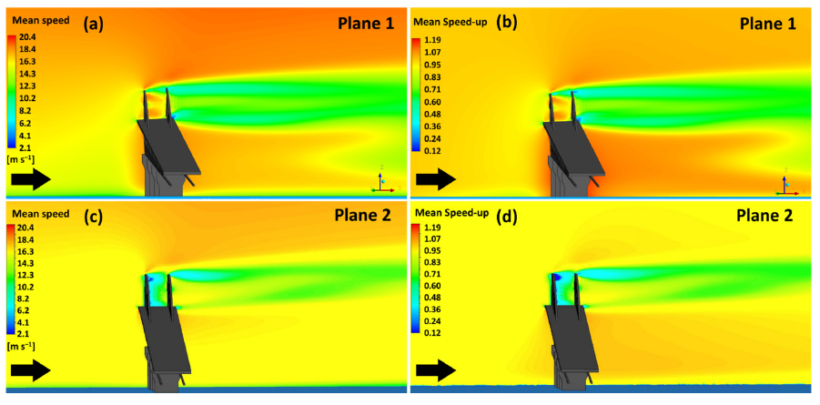
NWP Research
Model updates
Cross-NIWA collaboration with downstream modellers
NZ Reanalysis
NWP – CFD coupling
Amir Pirooz, Stuart Moore, Richard Turner
Notes:
https://www.mdpi.com/2076-3417/11/9/3982/
Looking at use of PALM and developing a UM2PALM wrapper

Slide 9
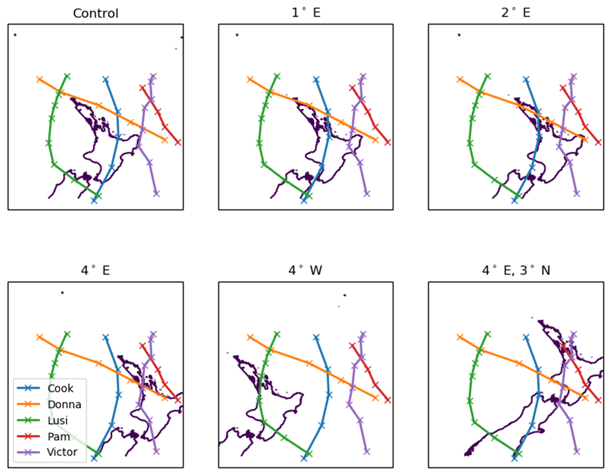
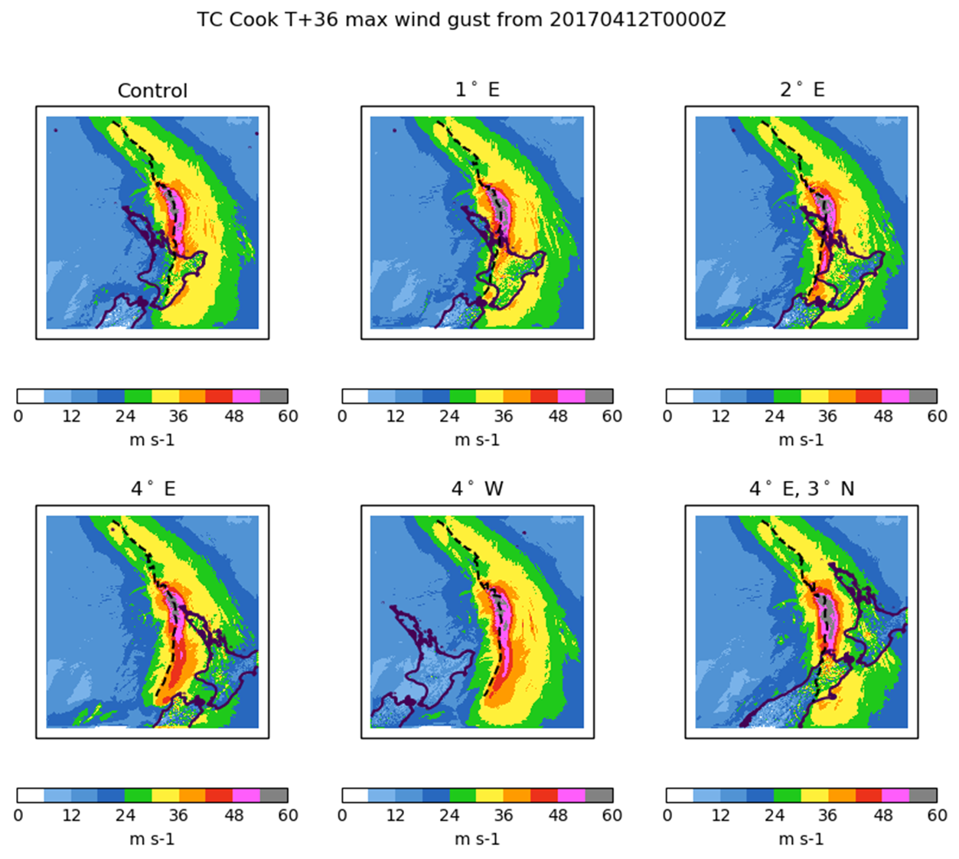
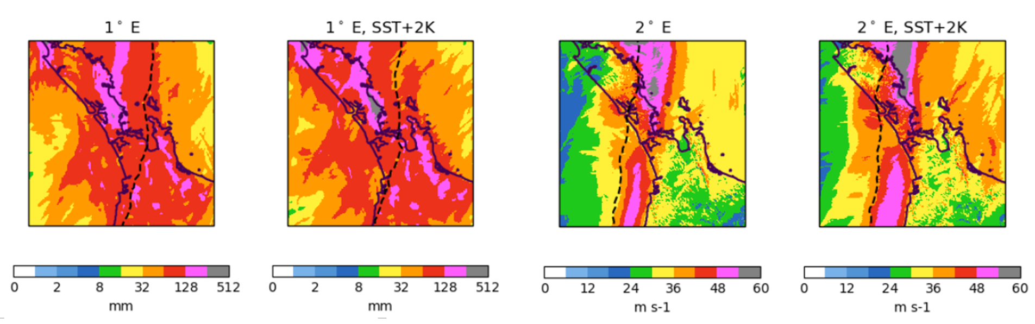
NWP Research
Model updates
Cross-NIWA collaboration with downstream modellers
NZ Reanalysis
NWP – CFD coupling
Resilience to Nature’s Challenges
Stuart Moore, Richard Turner, Ian Boutle (Met Office)
Notes:
https://resiliencechallenge.nz/scienceprogrammes/weather-theme/
exTC scenario modelling for downstream impacts over Auckland
Also nation-wide modelling of past winter storms (ice) and fire weather cases

Slide 10
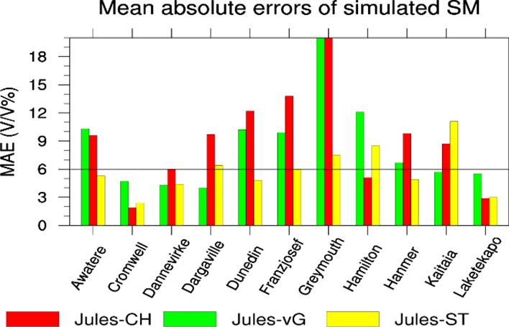
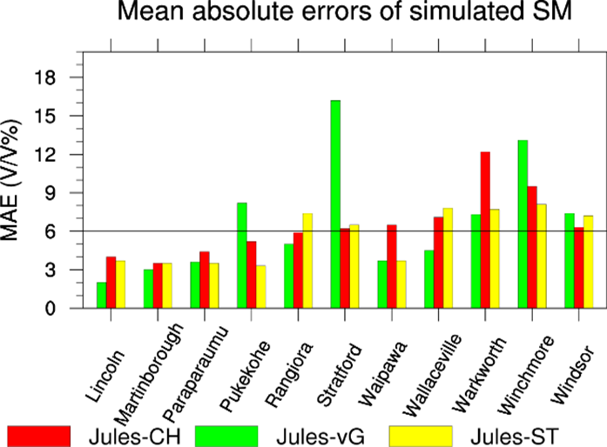
NWP Research
Model updates
Cross-NIWA collaboration with downstream modellers
NZ Reanalysis
NWP – CFD coupling
Resilience to Nature’s Challenges
Land Surface
Ed Yang
Notes:
Look to make use of locally derived soil and land classification datasets in JULES (and ultimately UM/LIS)
Soil data tested from LandCare’s S-map. Land use types to come from LCDB
Jules-CH – stone-adjusted soil parameters for Brooks and Corey (1964) model from S-map database
Jules-vG – soil parameters for van Genutchen (1991) model from S-map database
Jules-ST – soil texture types derived from S-map database and Table2 of Chen and Dudhia (2001)
Other ancil updates on snow cover (via a MODIS-derived snow cover dataset) and CCI updates

Slide 11
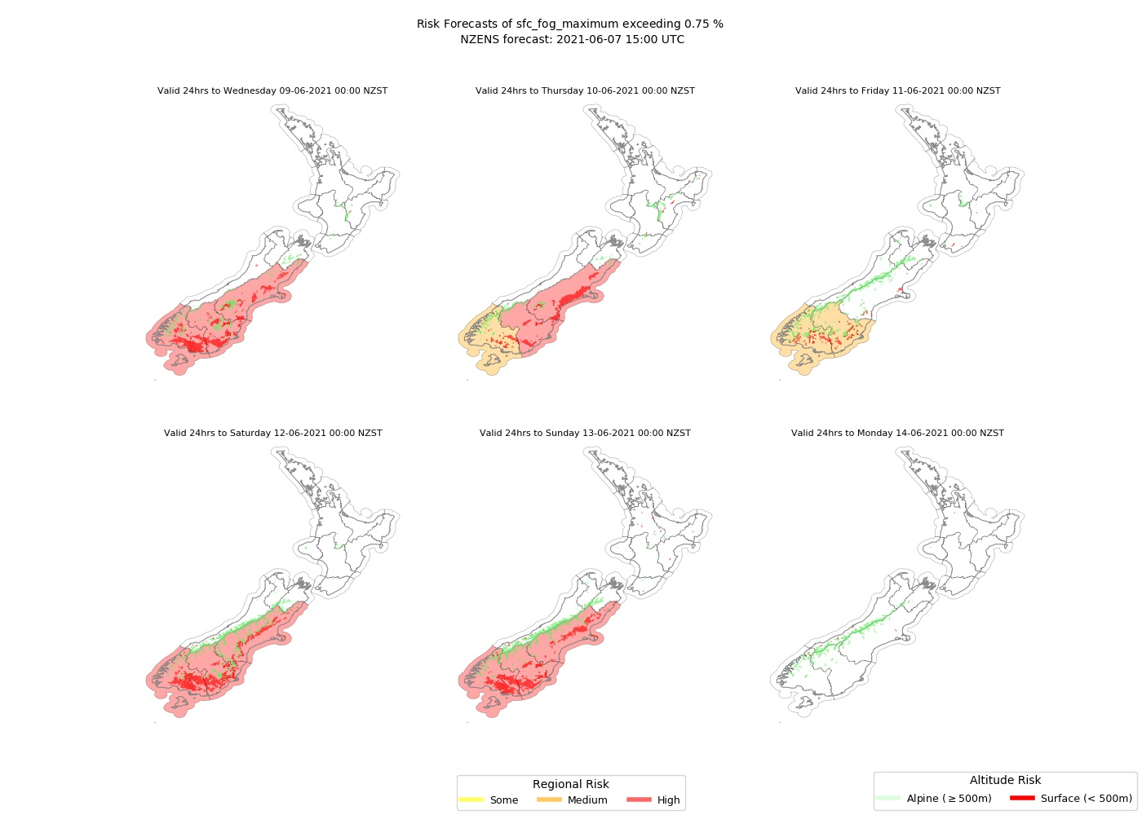
Forecasting Services
EcoConnect
Fire and Emergency NZ
Weekly hazardous weather outlook
24/7 call-a-forecaster
Chris Brandolino, Ben Noll, Seth Carrier, Nava Fedaeff, Tristan Meyers, Neelesh Rampal, Bernard Miville
Notes:
NIWA runs NWP-based Fire Weather Suite for key fire indices.
Risk Reports based on NZENS output and are based on NZ climate regions

Slide 12
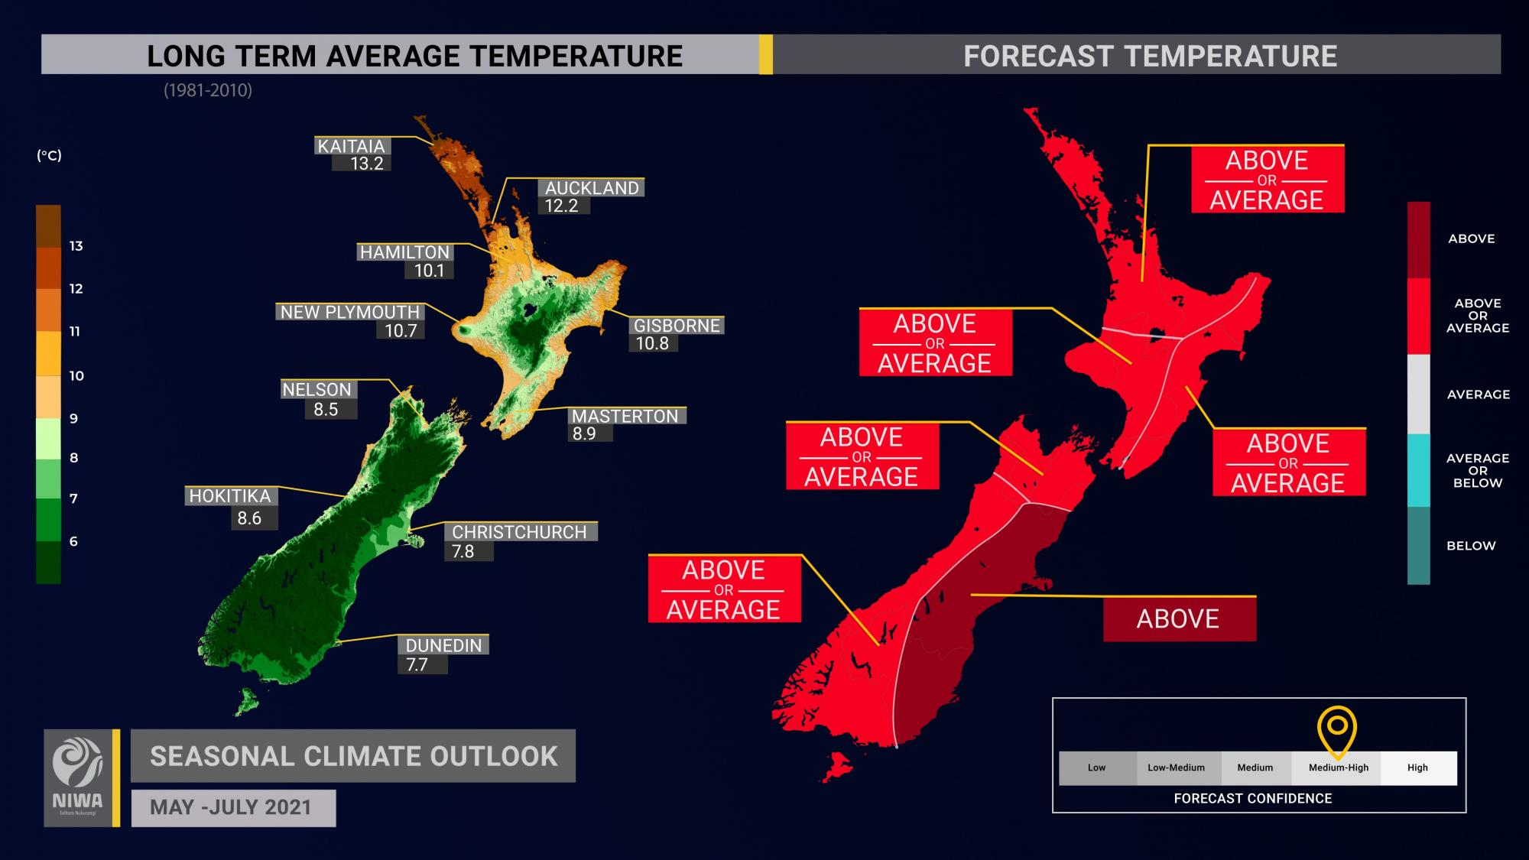
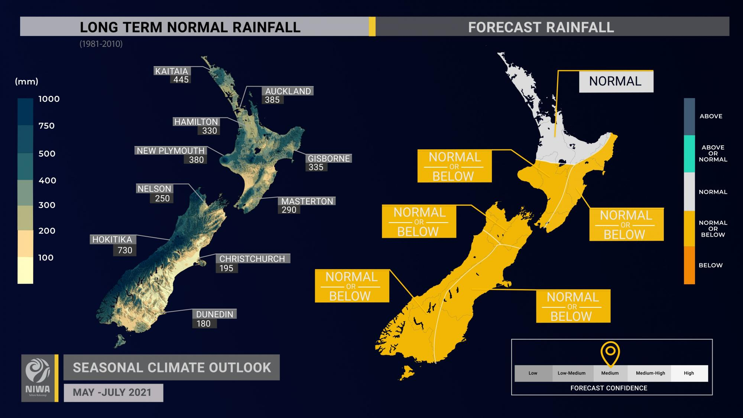
Forecasting Services
EcoConnect
Fire and Emergency NZ
Weekly hazardous weather outlook
24/7 call-a-forecaster
Department of Conservation
Public website, automated video content
Seamless forecasting across all models
24/7 call-a-forecaster
Emirates Team NZ
NWP, current and wave models run with forecaster guidance
Seasonal Climate Outlooks
Chris Brandolino, Ben Noll, Seth Carrier, Nava Fedaeff, Tristan Meyers
Notes:
https://niwa.co.nz/climate/seasonal-climate-outlook/seasonal-climate-outlook-may-july-2021
YouTube link - https://youtu.be/JEeazXPr1Uw
“We evaluate a range of international dynamic models (EC, UM, NCEP, etc.). We also consider climate drivers (ENSO, etc.)....which should be incorporated or 'seen' by the global models...but they have their flaws. We also consider the forecast MJO (intensity and location) as there are relationships between that and our sensible weather in NZ.” and analogue years

Slide 13
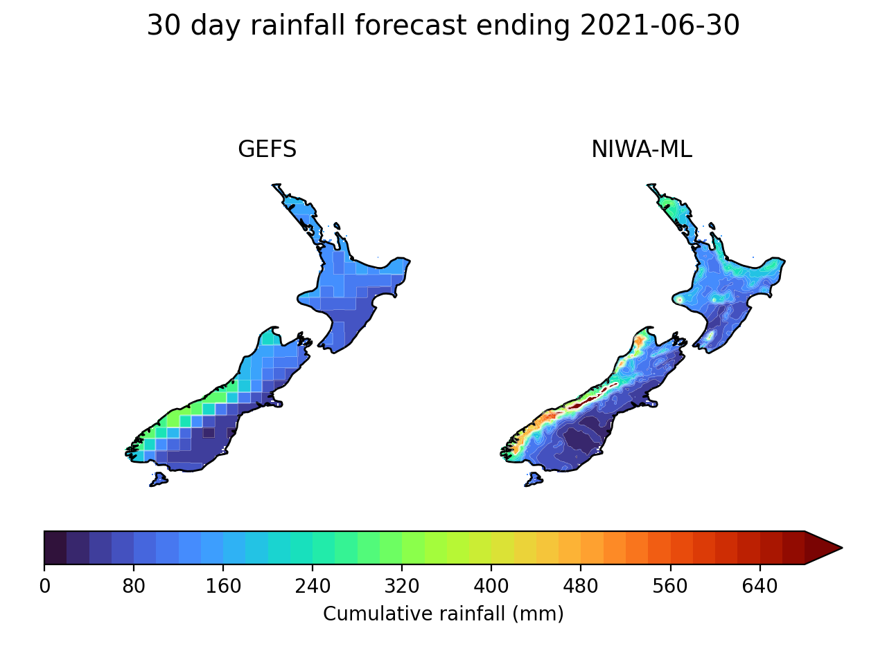
Data Science / ML
Statistical downscaling of global ensemble models using CNNs
Utilizes transfer learning
Scaling the GEFS of 50 km resolution down to ~5km resolution using the VCSN
Gives us bias correction of rainfall forecasts, including more realistic forecasts that resolve New Zealand’s complex terrain.
Neelesh Rampal, Ben Noll, Tristan Meyers

Slide 14
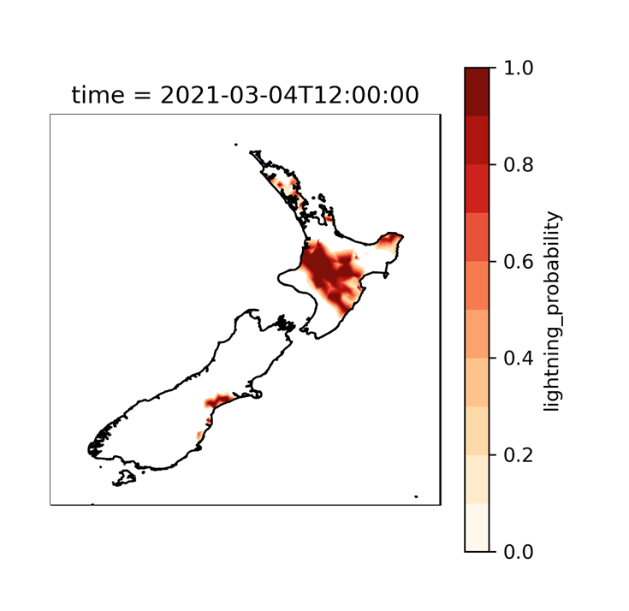
Data Science / ML
Improving forecast fields
Use NZENS forecasts
Bayesian methods for improving lightning forecasts across New Zealand
Neelesh Rampal, Ben Noll, Tristan Meyers

Slide 15
Deep South Challenge and the NZESM
https://deepsouthchallenge.co.nz/
Inform stakeholders in New Zealand about climate change.
Based on UKESM
Embedded a nested high-resolution ocean model around Aotearoa New Zealand.
Improved shortwave cloud radiative forcing – induced changes to stratocumulus cloud amount over the southern ocean.
“Development of the New Zealand Earth System Model” https://deepsouthchallenge.co.nz/wp-content/uploads/2020/11/Development-of-the-New-Zealand-Earth-System-Model.pdf
“Local Grid Refinement in New Zealand's Earth System Model: Tasman Sea Ocean Circulation Improvements and Super-Gyre Circulation Implications” https://doi.org/10.1029/2019MS001996
Jonny Williams, Erik Behrens, Vidya Varma, Olaf Morgenstern

Slide 16
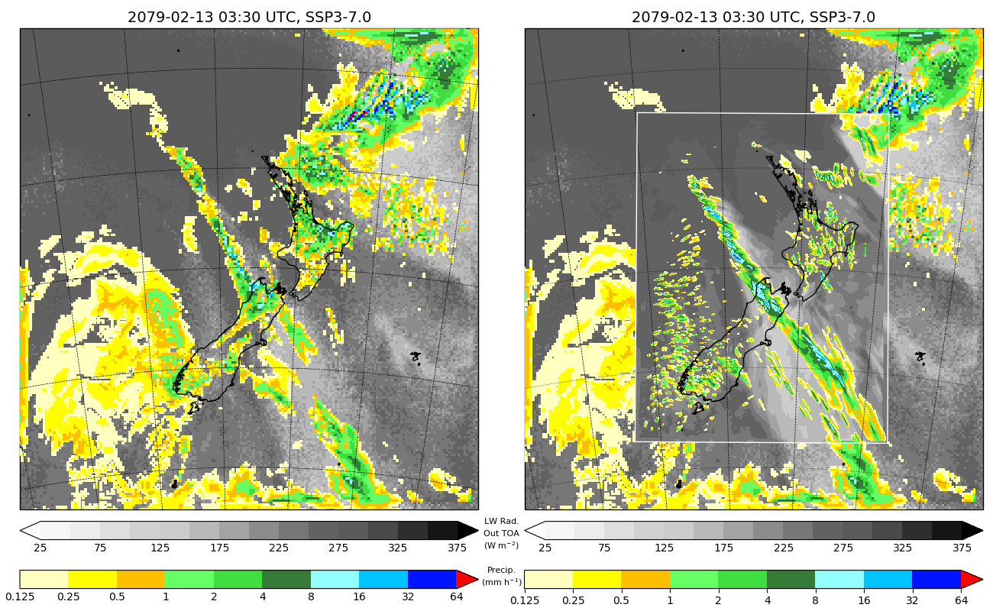
Regional Climate Modelling
Simulations of future New Zealand climate to 2100 at 12km resolution under low- to high-range emissions scenarios (Shared Socioeconomic Pathways, SSPs), using a regional climate model (RCM) based on UM Global Atmosphere 7.0 (GA7.0) configuration and forced by the New Zealand Earth System Model (NZESM).
Experimental modelling of New Zealand climate at 2.2km resolution using a Convection-Permitting regional climate Model (CPM) based on the HadREM3-RA11M configuration of the UM.
Stephen Stuart
Notes:
Hourly total precipitation (coloured shading) and outgoing longwave radiation at top of atmosphere (black and white shading) from 03:00 to 04:00 UTC on 13 Feb 2079, as simulated by 12km RCM (left, and right, outer domain) and 2.2km CPM (right, nested inner domain) forced by NZESM under SSP3-7.0.
(Though in case anyone asks, using this 2.2km CPM under a future emissions scenario, I’ve simulated only one month [i.e., February 2079], just to confirm that I can. I’ve done longer [i.e., ~1-year] historical simulations using this model forced by ERA-Interim reanalyses.)

Slide 17
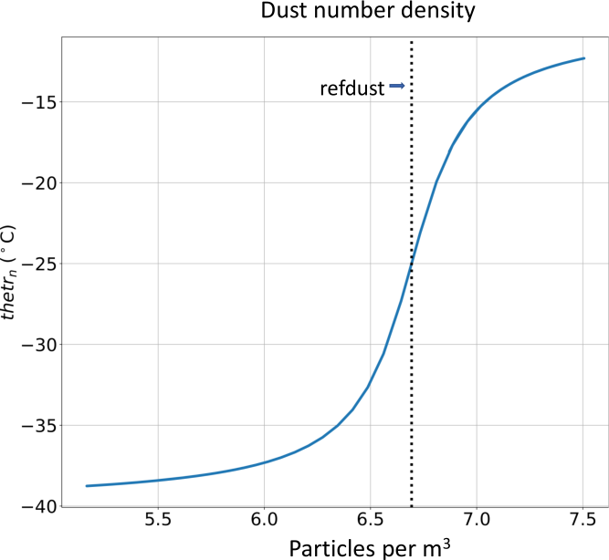
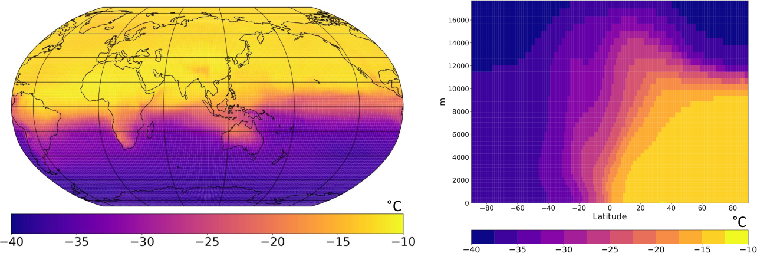
NZESM
Ice Nucleating Particles
A simple heuristic micro-physics parametrisation is being developed at NIWA whereby heterogeneous ice nucleation temperature is made to vary three-dimensionally as a function of mineral dust distribution in the Unified Model
As a result, those regions with less (more) dust number density would have lower (higher) nucleation temperature compared to the default global value of −10°C.
This scheme is now available in UM trunk vn11.9 onwards (work still in progress)
(Log₁₀ scale)
Vidya Varma

Slide 18
Questions?
Stuart Moore
+64 4 386 0756
stuart.moore@niwa.co.nz

